Slide 1
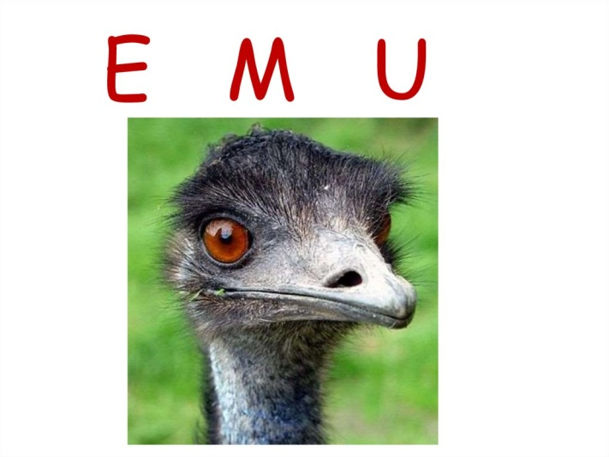
This wonderful emu!
Презентация к открытому уроку
3 класс
Модуль « Animals»

Slide 2
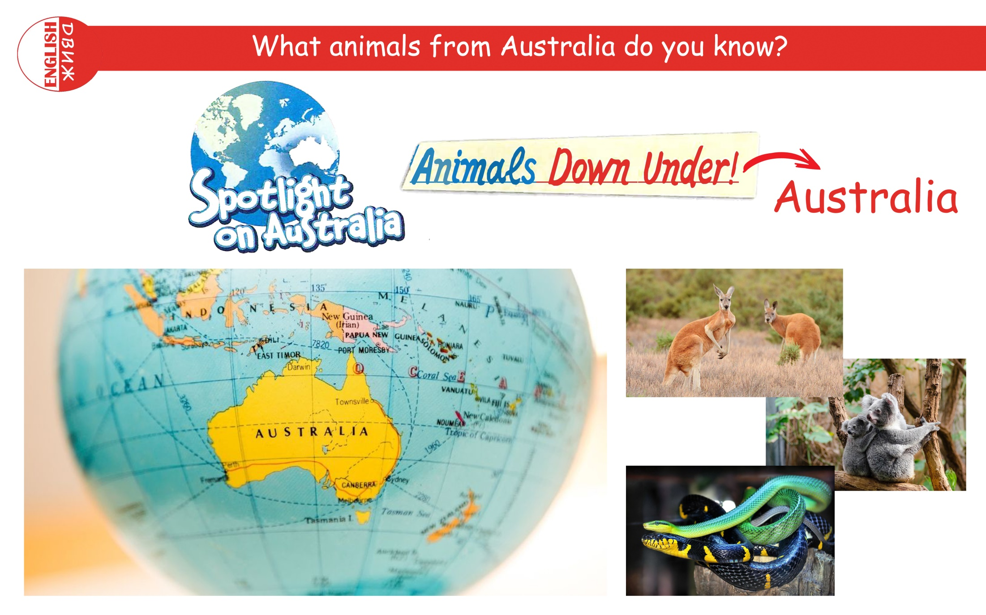

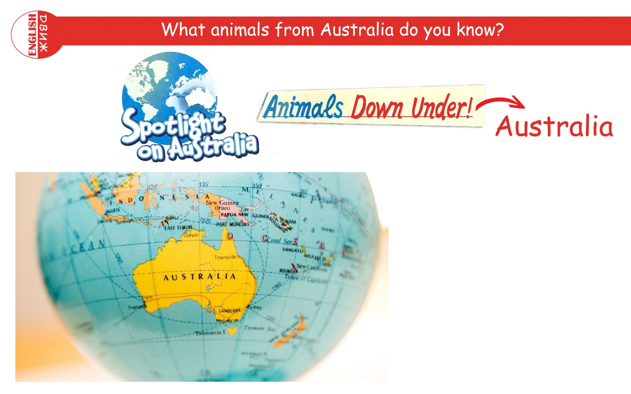
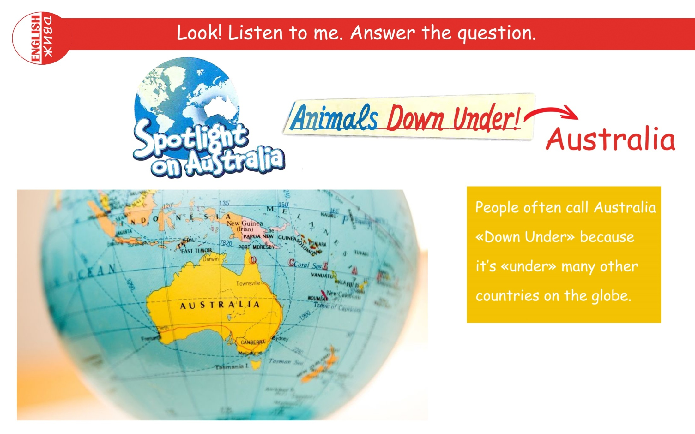


Slide 3

Welcome to Australia!

Slide 4
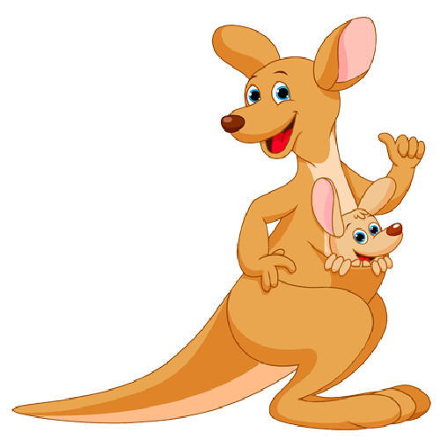
K is for Kangaroo!
How are you, Kangaroo ?
How are you?
Kangaroo, Kangaroo,
How are you?
I’m a happy Kangaroo!
How are you?
How are you?
I’m happy ,too,Kangaroo!

Slide 5
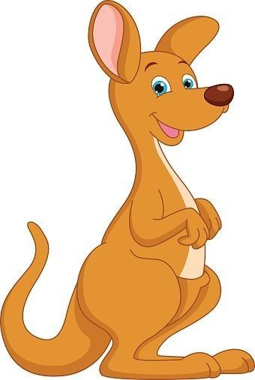
Checking Homework!
__________are from Australia.
They are ________.
They have got _____,______,
_______.
They can ______and ______
but they can’t ______.
__________ are very interesting animals.

Slide 6
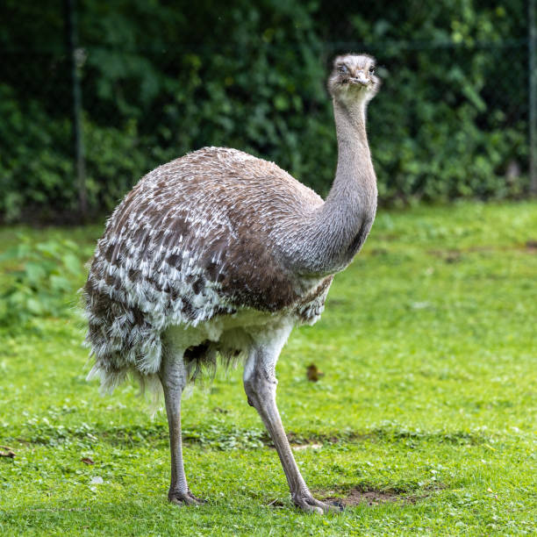
We are talking about emus!

Slide 7
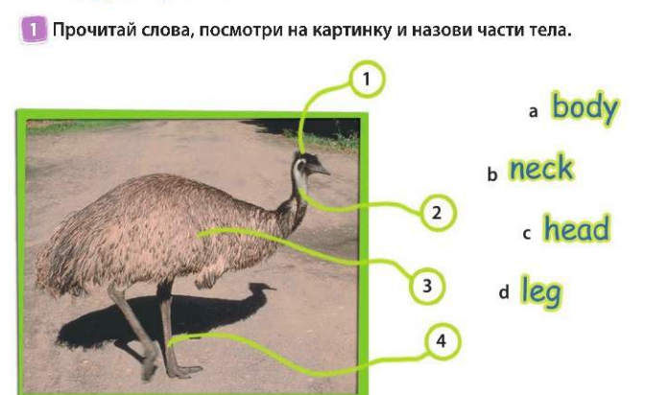
Task № 1

Slide 8
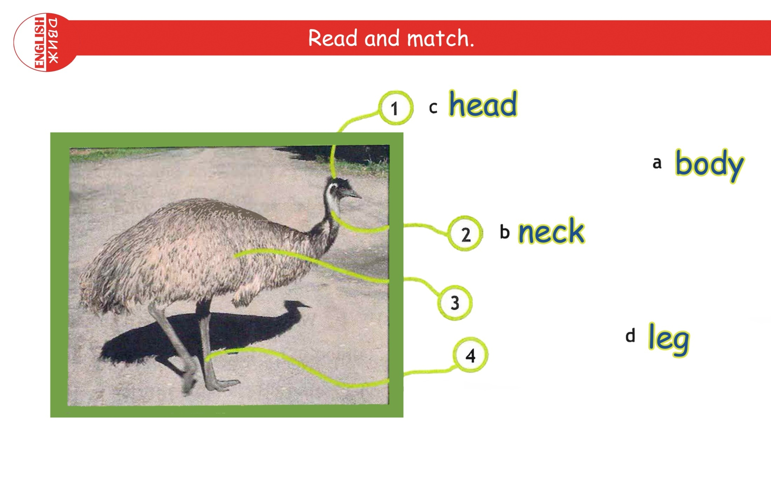
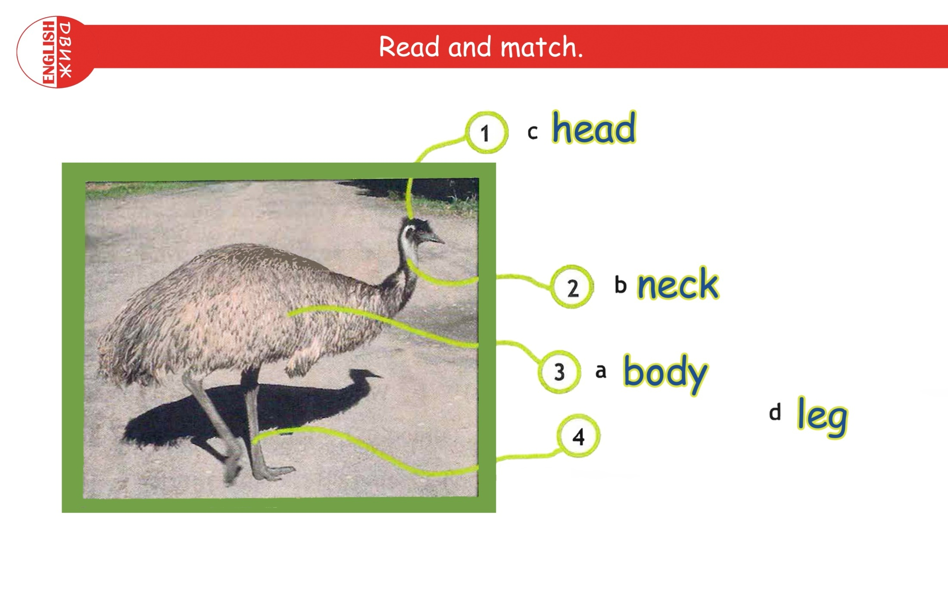
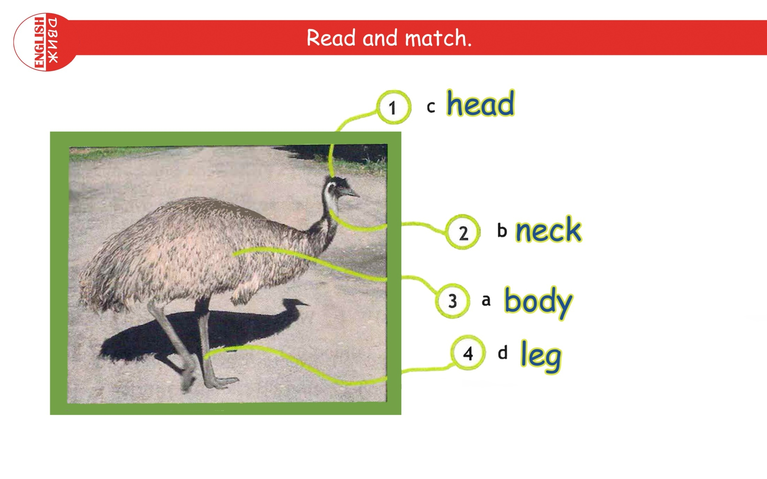
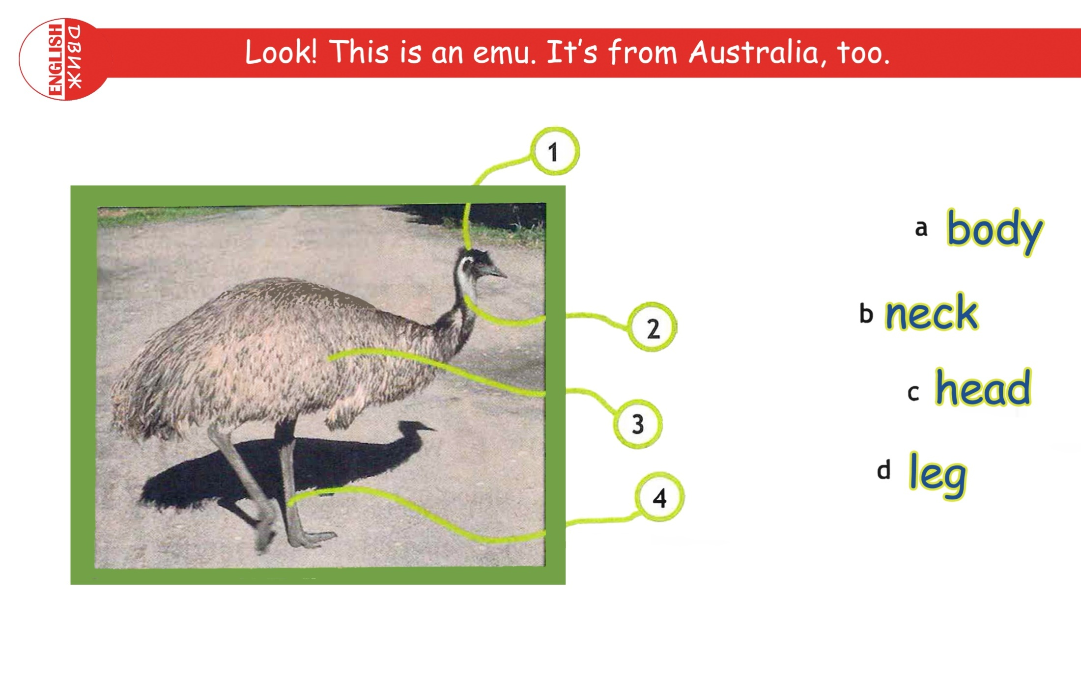
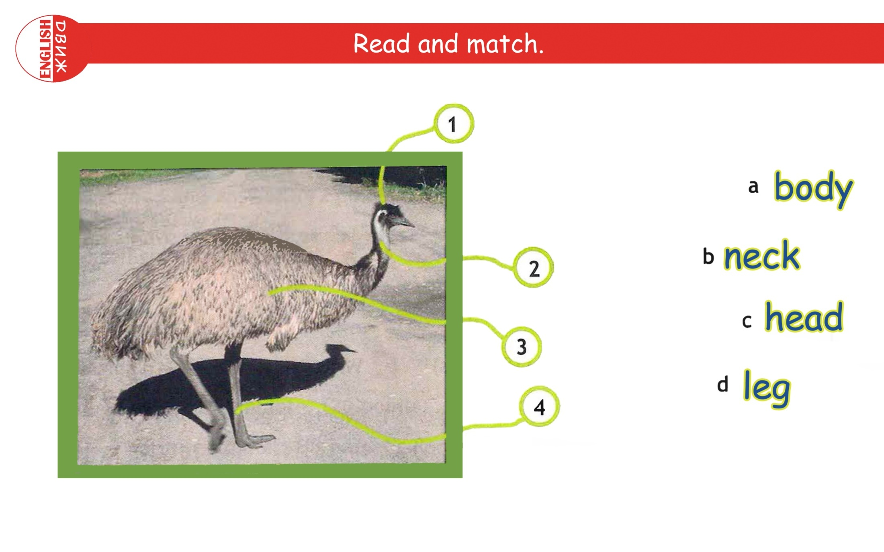
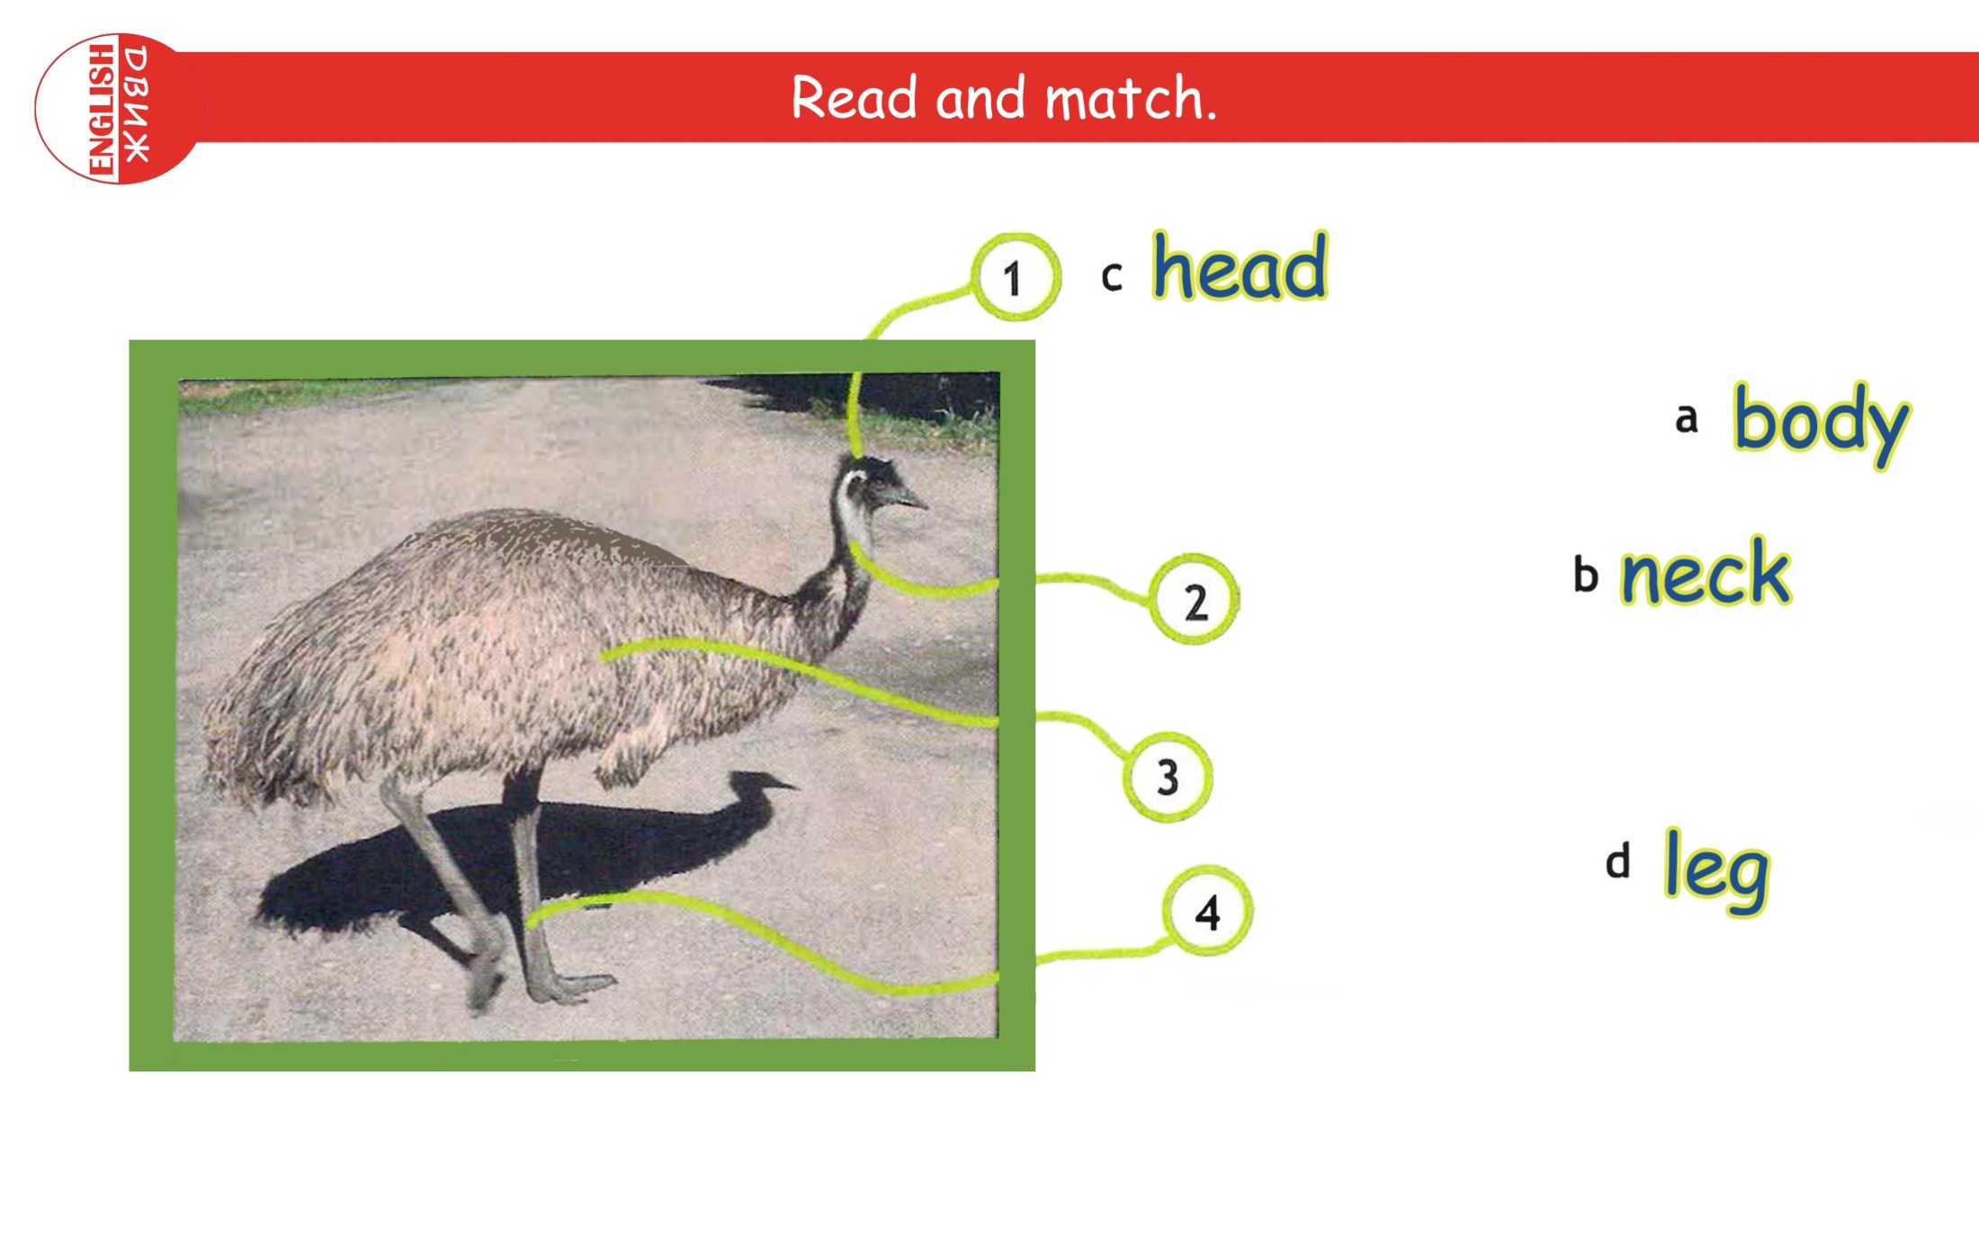
Read and match

Slide 9

Ex. 2 Read and Match!
a small head
2. a long neck
3. a big body
4. strong legs

Slide 10

Listen and repeat!
Emu
An emu
An emu from Australia
An emu from Australia is interesting!
insects
insects and fruit
Emus eat insects and fruit.

Slide 11
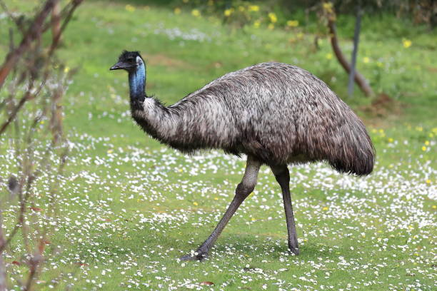
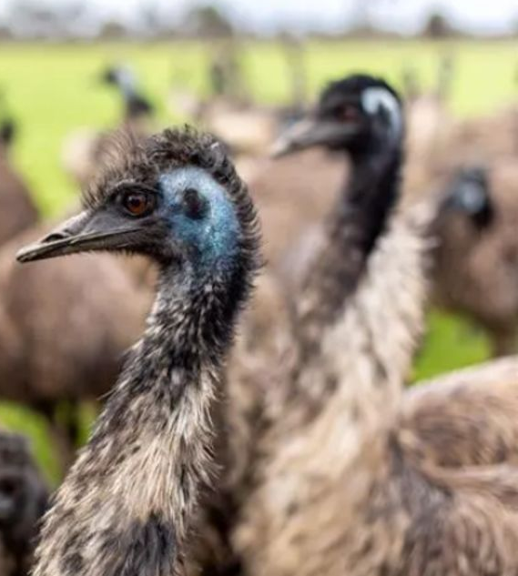
This is an emu.
Emus are from Australia.
In Australia there are a lot of emus farms.

Slide 12
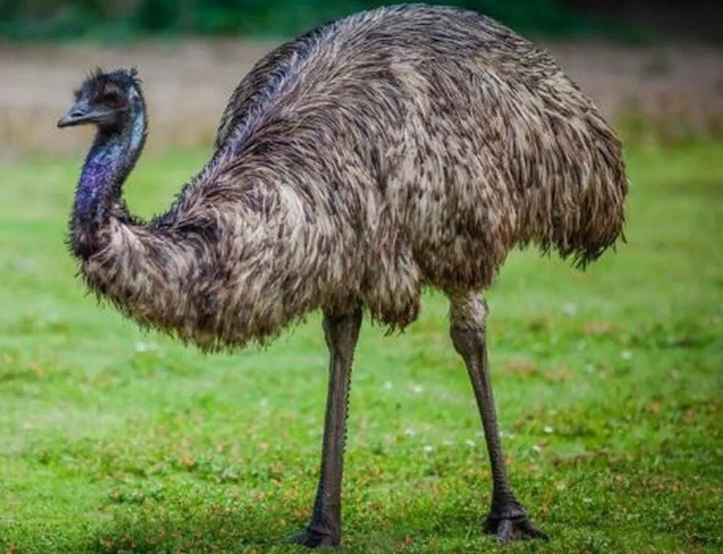
Emus are very tall with a big body,
a small head and long legs.
An emu’s body and legs are brown
and its head and neck are blue.

Slide 13
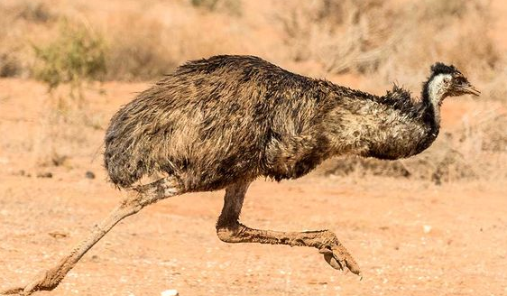
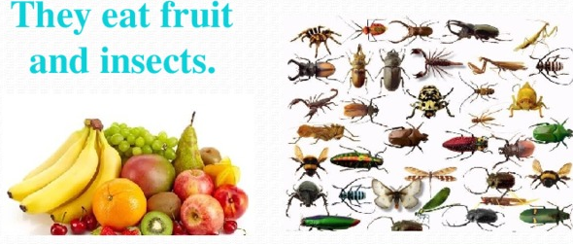
Emus can run very fast, but they can’t fly.

Slide 14
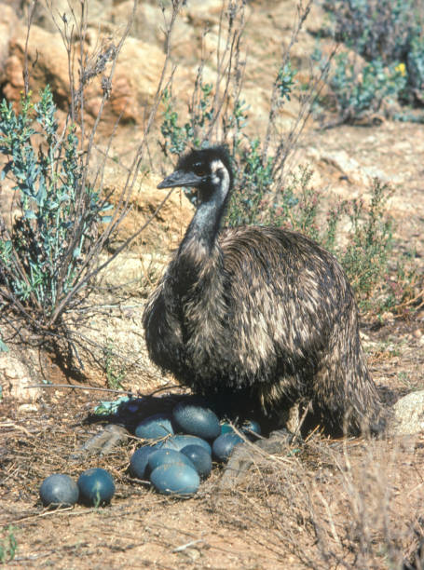
Their eggs are green.

Slide 15
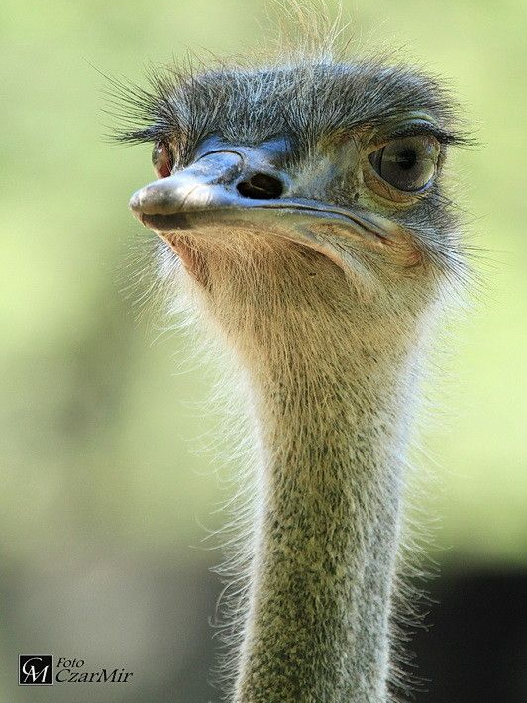
Emus are very interesting birds!

Slide 16
Ex.3 Fill in.
Animal - an emu
Country-__________________
Body- ___________________
Head- ____________________
Legs-__________________
Can-____________________
Can’t -____________________
Eat - ___________________

Slide 17
Ex.3 Fill in.
Animal - an emu
Country-Australia
Body- big,brown
Head-small,blue
Legs-long,brown
Can- run fast
Can’t -fly
Eat – fruit and insects

Slide 18

What have you learnt about emus from the text
true | false | Emu’s facts | true | false
 |  | Emus live in Africa.
 |  | They are small birds.
 |  | Emus have a small head and long legs.
 |  | They eat insects.
 |  | Emus can fly very well.
 |  | They run very fast.
 |  | They can live in a farm.

Slide 19
Ex.5
Emus are from ______________.
They are _______.
An Emu’s head and neck are ________.
Its legs and body are ________.
Emus can _____ but they can’t _______.
They are very interesting birds.

Slide 20
Ex.5
Emus are from Australia.
They are big.
An Emu’s head and neck are blue.
Its legs and body are brown.
Emus can run but they can’t fly.
Emus are very interesting birds.

Slide 21
Interesting facts about emus!
1. Emus are symbols of Australia.
2. They have three toes on each foot.
3. They can go long distances.
4. Emus drink a lot of water.
5. They can run very fast. ( 50 km/ h)
6. The eggs are big and green.
7. Emus are very curious. (любопытные)
8. They can swim very well.
9. Emus live for 30 years.

Slide 22
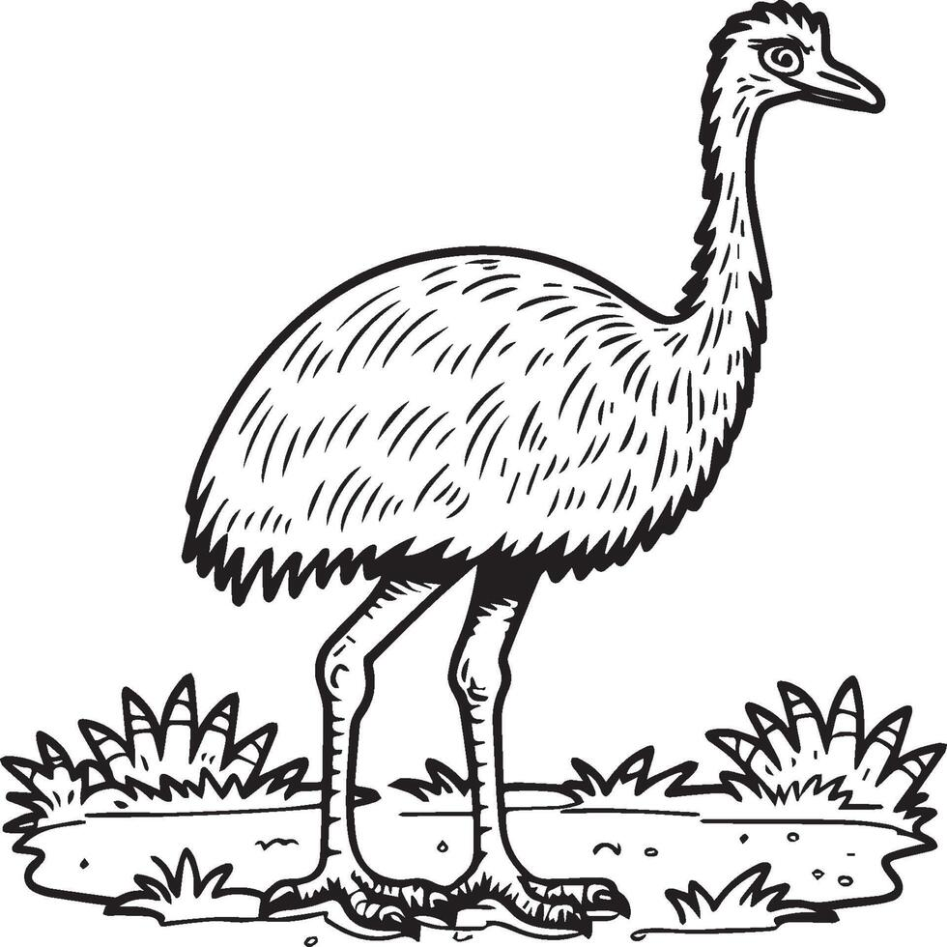
ex.6
This wonderful emu!

Slide 23
Homework!
SB. p.17 ex.2 ( у)
Уметь рассказывать об эму

Slide 24

Thank you !
You are great!

