Slide 1

My Family!

Slide 2
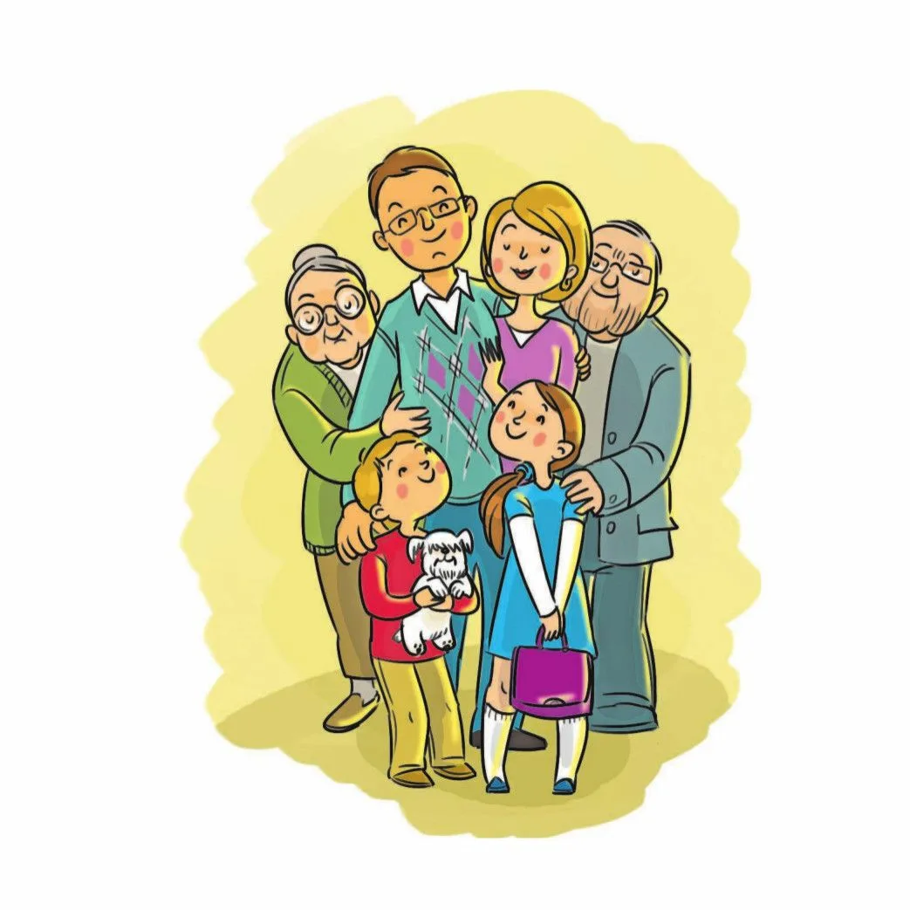
Let’s say together!
Mummy
Daddy
Grandma
Grandpa
Sister
Brother

Slide 3
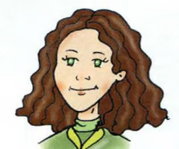
Lulu’s family!
This is my mummy.

Slide 4

Lulu’s family!
My name is Lulu. Meet my family!
This is my mummy. This is my daddy.
Look at my grandma and grandpa!
This is my brother Larry.
I love my family!

Slide 5
Your Families!
Speak about your Family
Tell us their names !
It’s Homework check up.
Your mini- projects . WB p. 13 ex.4

Slide 6
Let’s check up!
a). _ umm _ e). _roth_r
b). d_d_y f). s_ste_
c). _randm_ g). _ arry
d). grand_a h). L _lu

Slide 7
Colours
Let’s say together!
Yellow Red
Green Orange
Blue Pink
Brown Purple
White Black

Slide 8
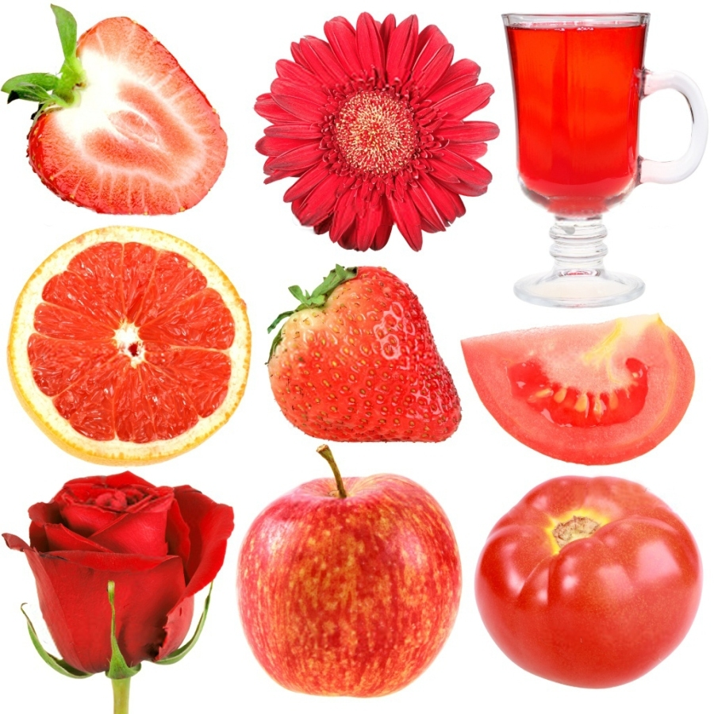
What colour is it?

Slide 9
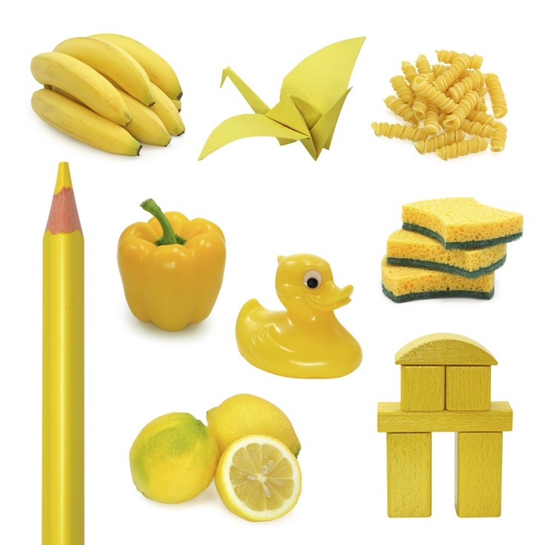
What colour is it?

Slide 10
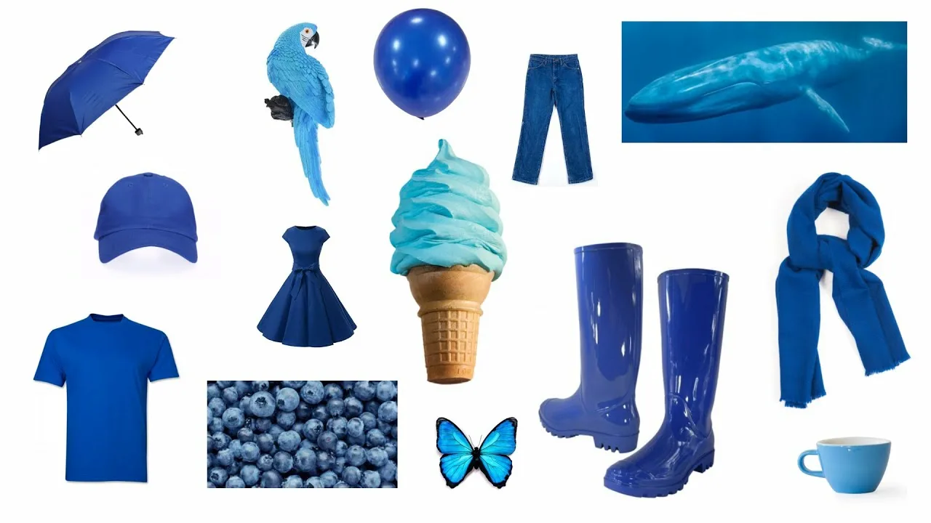
What colour is it?

Slide 11

What colour is it?

Slide 12
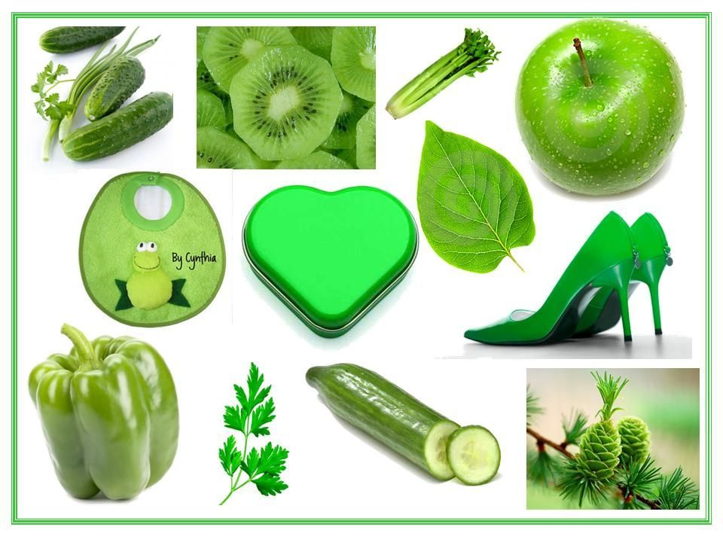
What colour is it?

Slide 13
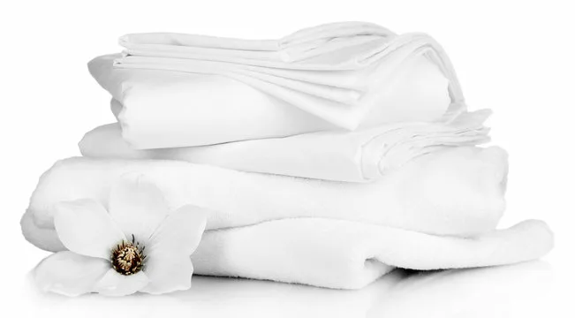
What colour is it?

Slide 14
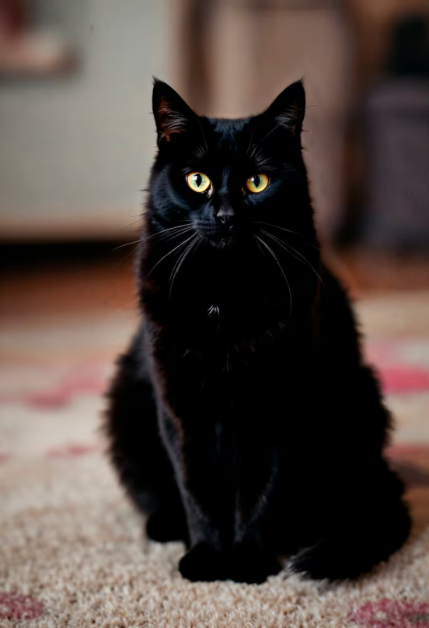

What colour is it?
a black cat a black pen

Slide 15
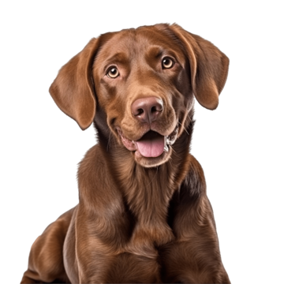

What colour is it?
a brown dog
a brown window

Slide 16
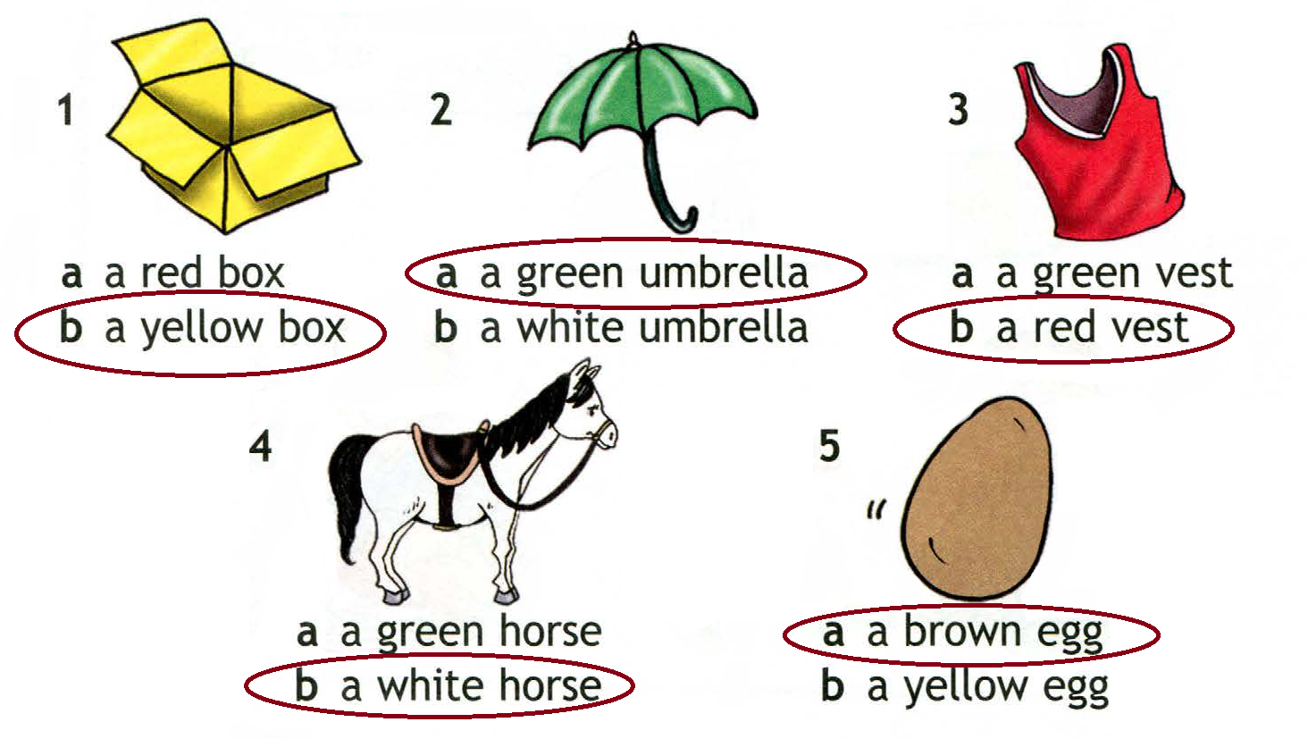
Let’s check up!

Slide 17


Your Homework
Нарисовать 5 предметов в тетради.
Подписать их цвета и названия.
e. g. a green book
a red umbrella

