Slide 1
My House !

Slide 2
Let’s Warm up!
What’s this?
house
a house
a green house
It’s a green house.

Slide 3

Brown Dog
dog
a dog
a brown dog
It’s a brown dog.

Slide 4
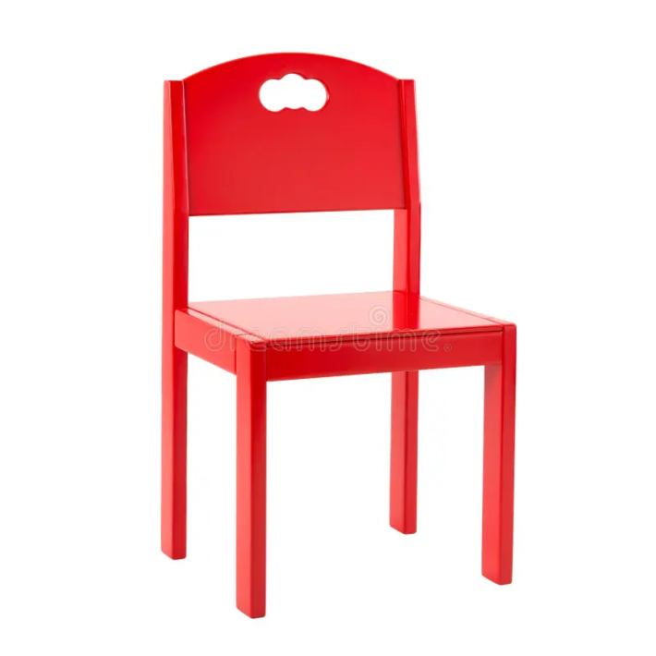
A Red Chair
chair
a chair
a red chair
It’s a red chair.

Slide 5

A yellow table What’s this?
table
a table
a yellow table
It’s a yellow table.

Slide 6

What’s this? A blue Radio
radio
a radio
a blue radio
It’s a blue radio

Slide 7
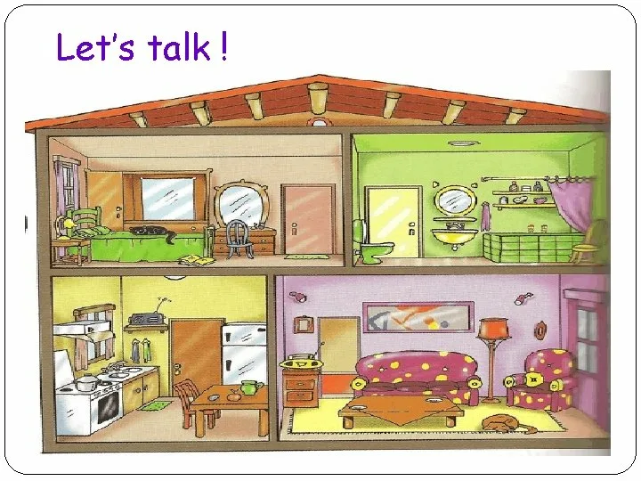
Rooms in the house

Slide 8
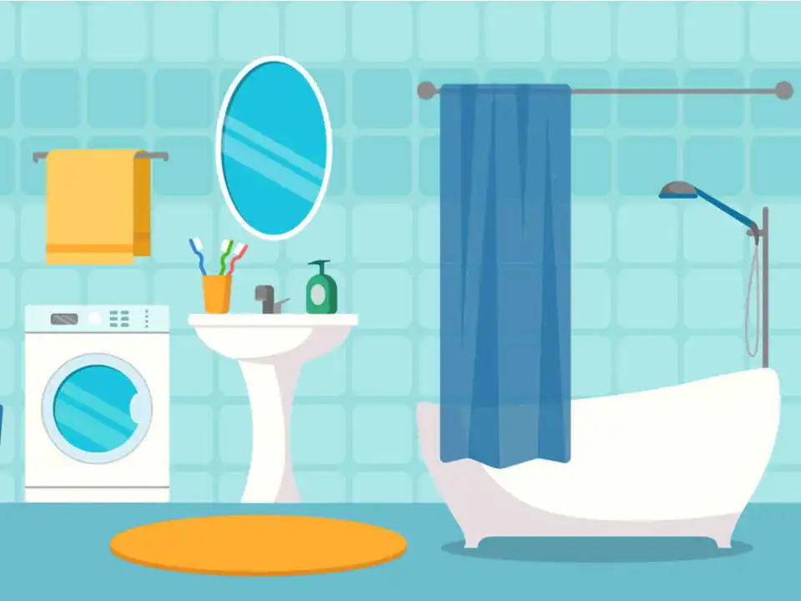
Bathroom bath + room

Slide 9

Bath

Slide 10

Bedroom bed+room

Slide 11
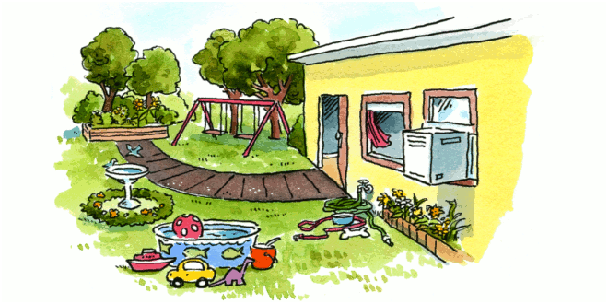
Garden

Slide 12
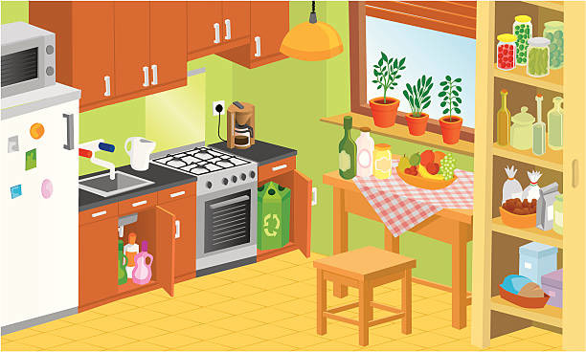
Kitchen

Slide 13
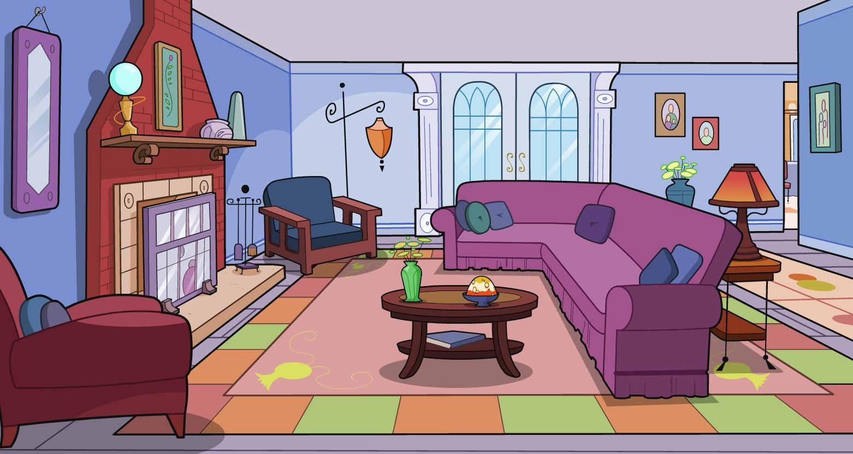
Living room

Slide 14
Fill in the letters .
l _ v i n g r o _ m k i t c _ e n
b e _ r o o m h _ u s e
b a _ h r o o m b _ t h
g a _ d e n b _ d

Slide 15
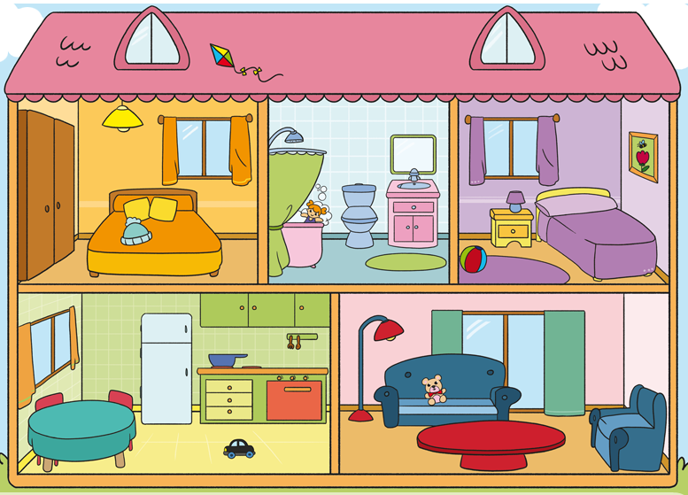
Match a picture and a word
Where’s in the house?
bedroom
garden
living room
kitchen
bathroom

Slide 16


Proverbs about home
East or West, home is best!
В гостях хорошо, а дома лучше!

Slide 17

Proverbs about home
My home is my castle.
Мой дом - моя крепость.

Slide 18

Proverbs about home
Home sweet home .
Дом, милый дом.

Slide 19

Proverbs about home
There’s no place like home .
В гостях хорошо, а дома лучше.

Slide 20


He She
mummy
Lulu
grandpa
sister
daddy
grandma
Larry
Chukles

Slide 21
Where’s Chukles?
He’s in the bedroom.
He’s in the garden.
He’s in the kitchen.
He’s in the bathroom.

Slide 22

Where’s Chukles?

Slide 23
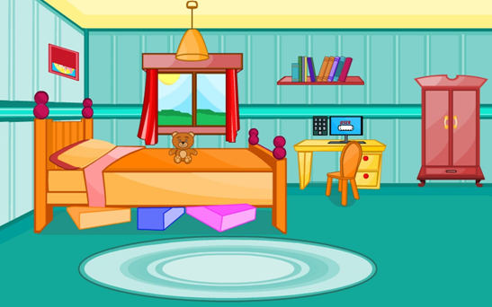
Your Homework !
SB p. 38
Draw and write about your room.
Project “My Room”

