Slide 1
Fragile planet

Slide 2
plan
Look at mind map
Remember words
Work with text
Answer the questions and find beginnings of sentences
Complete mind map

Slide 3
MIND MAP
WEATHER
NATURAL WORLD
CLIMATE
PEOPLE
ENVIRONMENT
?
Greenhouse effect, climatic changes, carbon dioxide, atmosphere
Temperature, forecast
PLANET
Extinct birds and animals, habitats, insects
Illnesses, life in city and in countryside, food

Slide 4
Environment (noun) [ɪnˈvaɪrənmənt]
the air, land, and water where people, animals, and plants live
the natural world in which people, animals and plants live

Slide 5
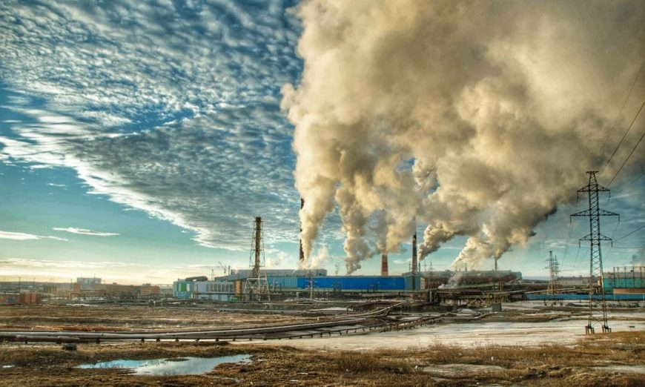
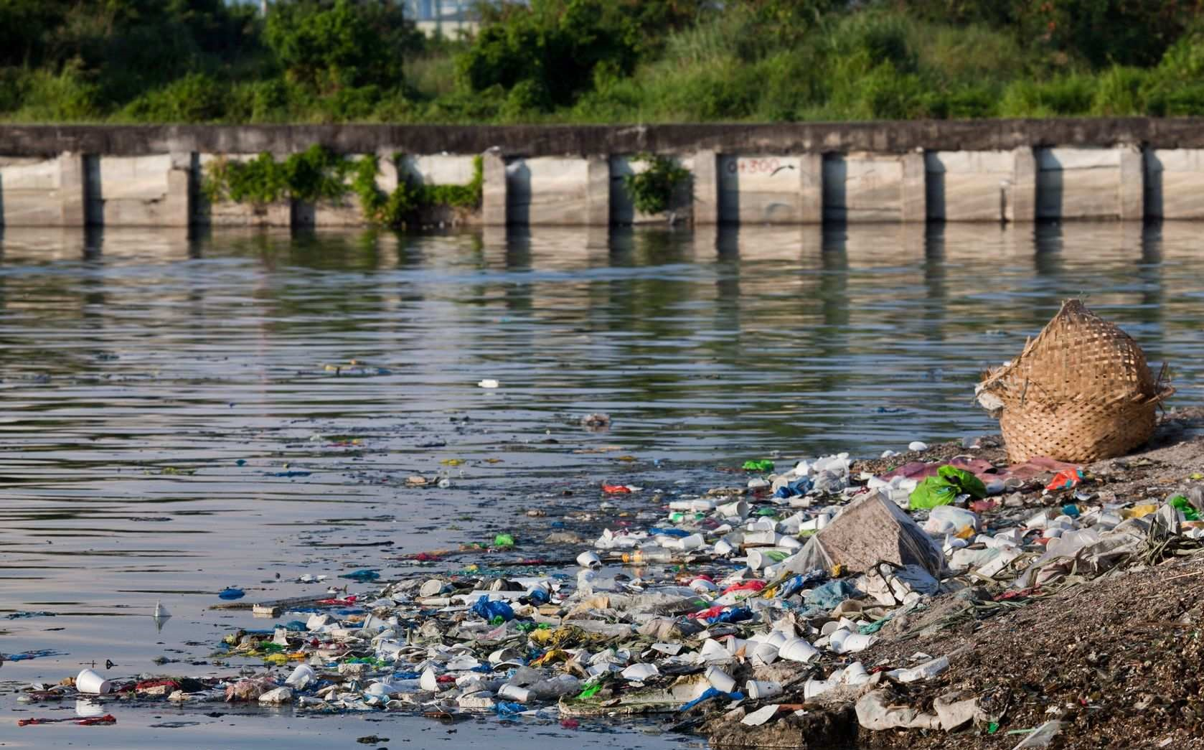
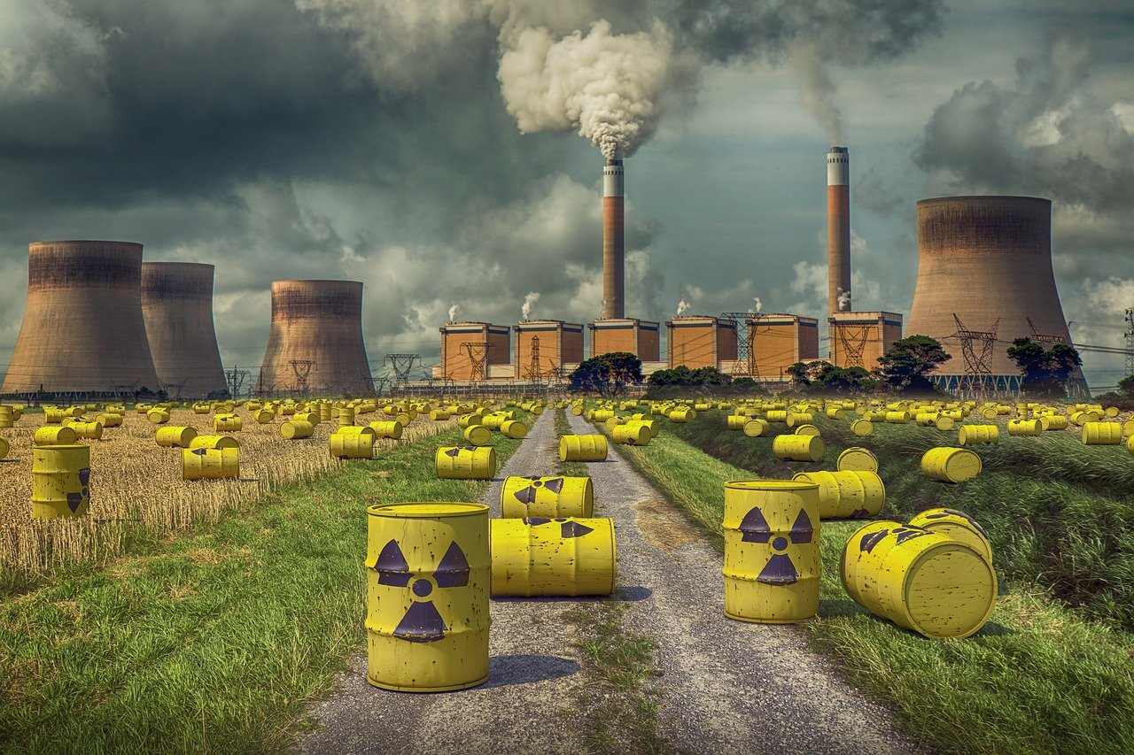
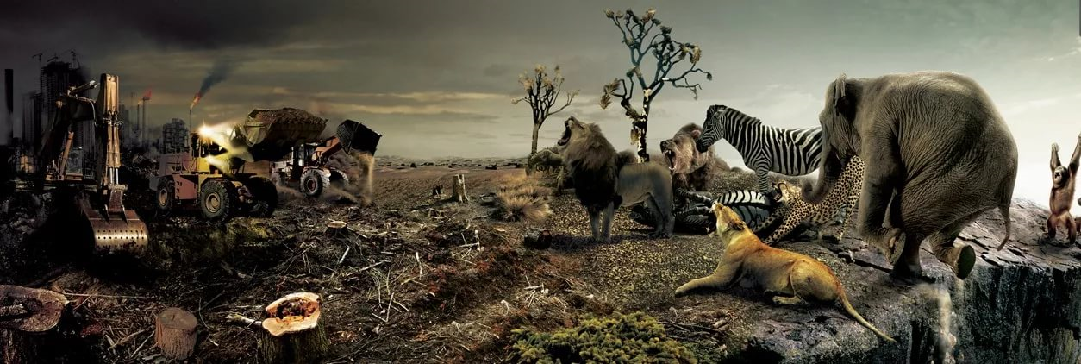
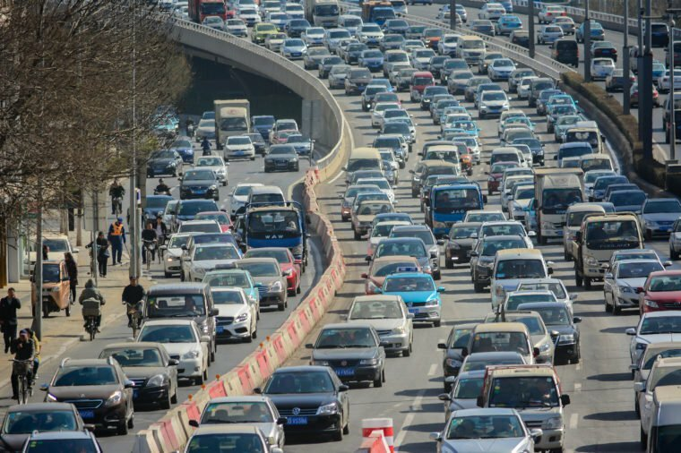
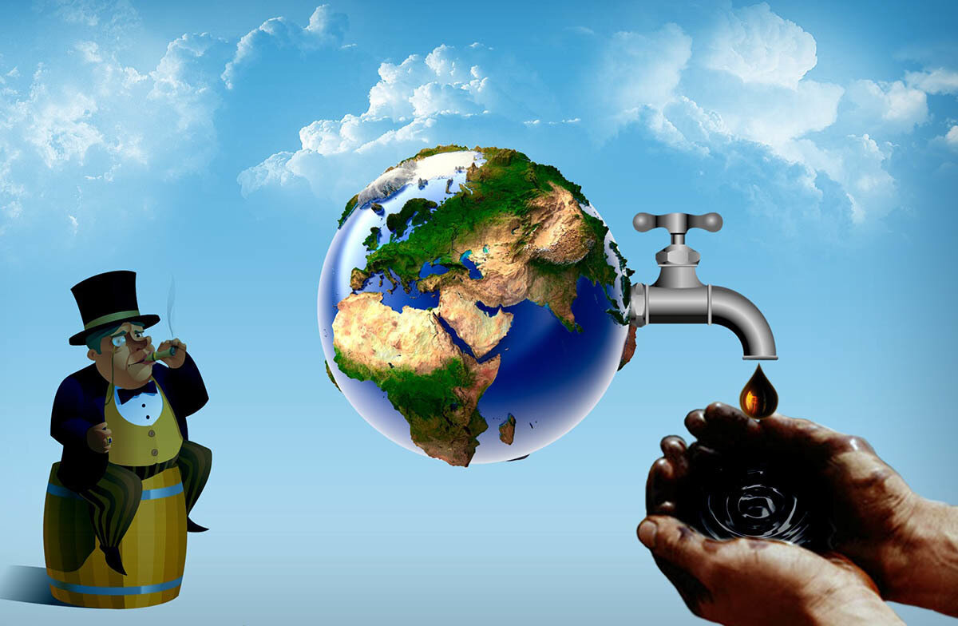
Growth of population
A lot of factories and plants
Air pollution
Water pollution
Nuclear pollution
Noise from
transport
Shortage of natural resources
Destruction of wildlife

Slide 6
Ex.20 (a) p.58-59
Text “Fragile planet”

Slide 7
Answer the questions:
What makes sea water dangerous nowadays?
Why is it dangerous to dump industrial waste in the sea?
Find beginning of sentences in the text:
a)….. we stand and walk, the water we drink are all part of the environment.
b)…...industrial and nuclear waste.
c)……habitats and many plants die.
d)……produce a lot of waste and pour it into rivers.

Slide 8
Environment-
means all around us!

Slide 9
MIND MAP
WEATHER
NATURAL WORLD
CLIMATE
PEOPLE
ENVIRONMENT
?
Greenhouse effect, climatic changes, carbon dioxide, atmosphere
Temperature, forecast
PLANET
All around us (air, water, plants, animals…)
Extinct birds and animals, habitats, insects
Illnesses, life in city and in countryside, food

Slide 10
plan
Look at mind map
Remember words
Work with text
Answer the questions and find beginnings of sentences
Complete mind map

Slide 11
homework
ксерокс, №20(B) стр 58-60 чит. перев.

Slide 12
Words
Население
Фильтр
Загрязнять
Оружие
Загрязнение
Разрушение
Экология
Нехватка
Отходы
Яд, отравить
Ресурсы
Ядерный
Выживать
Безопасный
Быть причиной, вызывать
Свалка, выбрасывать на свалку
resources
filter
ecology
to pollute
pollution
to cause
destruction
shortage
a population
dump
waste
poison
nuclear
weapon
to survive
safe

