Slide 1
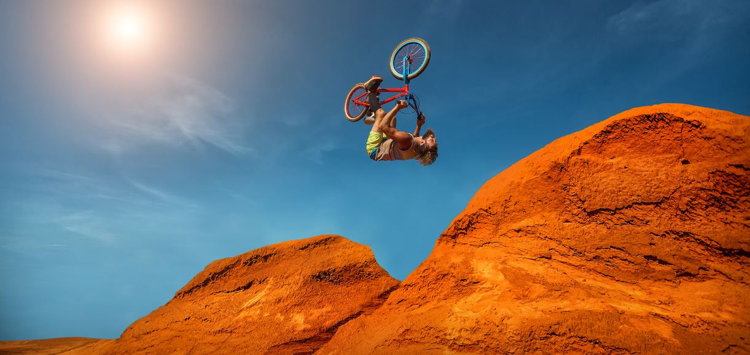
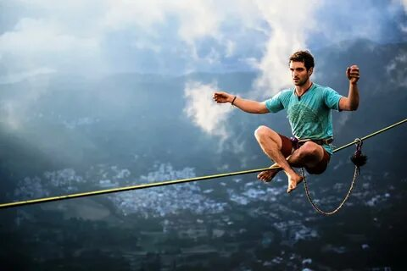
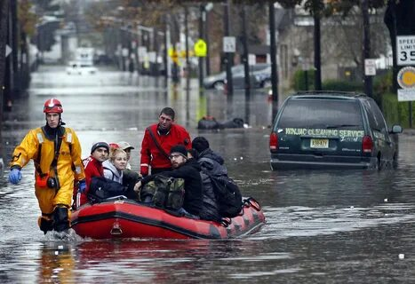
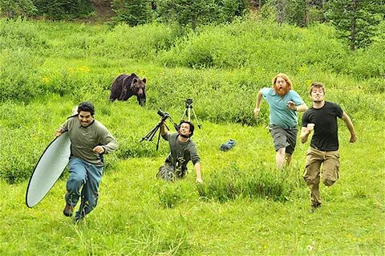

Slide 2
Ready to go Extreme?

Slide 3
What are your associations with the word “extreme”?
EXTREME
What kinds of extreme situations can you face in your lives?

Slide 4
Complete the text with the appropriate grammar.
“Extreme” refers to something that is beyond the usual or reasonable limits and often 1. _______ a level of danger or risk. It can be used to describe things like sports, weather, or behaviour. The word “extreme” 2. _______to describe situations or conditions that are intense, severe, or dangerous. For example, extreme weather conditions, such as hurricanes or 3. _________, are those that are particularly severe and can cause significant damage. When 4. _______ to physical activities, “extreme” means that they are challenging or dangerous. For instance, extreme sports, such as skydiving or base jumping, are 5. ______ that involve high levels of risk and require specialized skills and equipment. When used to describe emotions or attitudes, extreme means that they are intense or exaggerated. For example, extreme anger or fear 6. ______by intense feelings that are difficult to control. | IMPLY USE TORNADO REFER THESE CHARACTERISE

Slide 5
Complete the text with the appropriate grammar.
“Extreme” refers to something that is beyond the usual or reasonable limits and often 1. implies a level of danger or risk. It can be used to describe things like sports, weather, or behaviour. The word “extreme” 2. is used to describe situations or conditions that are intense, severe, or dangerous. For example, extreme weather conditions, such as hurricanes or 3. tornadoes, are those that are particularly severe and can cause significant damage. When 4. referring to physical activities, “extreme” means that they are challenging or dangerous. For instance, extreme sports, such as skydiving or base jumping, are 5. those that involve high levels of risk and require specialized skills and equipment. When used to describe emotions or attitudes, extreme means that they are intense or exaggerated. For example, extreme anger or fear 6. is characterised by intense feelings that are difficult to control. | IMPLY USE TORNADO REFER THESE CHARACTERISE

Slide 6
Watch the video.
What is the message of the video? /What does the author of the film want to say?
Choose the idea that is best suited.
All of us face challenges in our day to day lives.
Problems create a good opportunity for change.
Self-discovery is a continuous journey to understand ourselves better.

Slide 7
Watch the video.
What is the message of the video? /What does the author of the film want to say?
Choose the idea that is best suited.
All of us face challenges in our day to day lives.
Problems create a good opportunity for change.
Self-discovery is a continuous journey to understand ourselves better.
Is it time to leave your comfort zone for change?

Slide 9
ANGER
ANXIETY
SENSE OF CONTROL
SURPRISE
COMFORT ZONE
FEAR
ZONE
BOREDOM
FEAR
SAFETY
EXCITEMENT
STAGNATION
STRESS

Slide 10
stress-stressful
anxiety- anxious
excitement- exciting/-ed
anger-angry
fear- fearless/fearful
surprise-surprising/-ed
safety-safe
ANGER
ANXIETY
SENSE OF CONTROL
SURPRISE
COMFORT ZONE
FEAR
ZONE
BOREDOM
FEAR
SAFETY
EXCITEMENT
STAGNATION
STRESS

Slide 11
ORGANISE
PATIENT
ANGER
ANXIETY
COMPLETE
SENSE OF CONTROL
SURPRISE
FEAR
ZONE
LEARNING
ZONE
BOREDOM
COMFORT ZONE
FEAR
SAFETY
EXCITEMENT
SATISFIED
STAGNATION
SAFE
STRESS
ABLE
MOTIVATED

Slide 12
ORGANISE
PATIENT
ANGER
ANXIETY
COMPLETE
SENSE OF CONTROL
SURPRISE
FEAR
ZONE
LEARNING
ZONE
BOREDOM
COMFORT ZONE
FEAR
SAFETY
EXCITEMENT
SATISFIED
STAGNATION
SAFE
STRESS
ABLE
MOTIVATED
safe - unsafe able - unable
organise – disorganise motivated - unmotivated
patient – impatient satisfied - dissatisfied
complete - incomplete

Slide 13
What kind of precautions should be taken while doing extreme sports?

Slide 14
What kind of precautions should be taken while doing extreme sports?
I believe that people who do extreme sports should use suitable protective equipment.
content
grammar

Slide 15
What kind of precautions should be taken while doing extreme sports?
I believe that people who do extreme sports should use suitable protective equipment.
content
grammar

Slide 16
Do Russian teenagers like taking part in risky sports? Why?

Slide 17
Definitely, Russian teenagers like taking part in risky sports. They can to get excitement. Doing extreme sports, they feel alive and get a rush that they don’t experience in everyday life.
Do Russian teenagers like taking part in risky sports? Why?
content
grammar

Slide 18
Definitely, Russian teenagers like taking part in risky sports. They can to get excitement. Doing extreme sports, they feel alive and get a rush that they don’t experience in everyday life.
Do Russian teenagers like taking part in risky sports? Why?
content
grammar

Slide 19
Have attitudes to extreme sports changed in recent years?

Slide 20
I think that today people are more likely to try extreme sports. Such sports become more popular because of media.
Have attitudes to extreme sports changed in recent years?
content
grammar

Slide 21
I think that today people are more likely to try extreme sports. Such sports become more popular because of media.
Have attitudes to extreme sports changed in recent years?
content
grammar

Slide 22
Do you think extreme sports are more popular among men or women?

Slide 23
Do you think extreme sports are more popular among men or women?
I think extreme sports are more popular among men because they are more stronger and braver than women.
content
grammar

Slide 24
Do you think extreme sports are more popular among men or women?
I think extreme sports are more popular among men because they are more stronger and braver than women.
content
grammar

Slide 25
What makes people do extreme sports?

Slide 26
People do extreme sports to challenge themself. They want to test their limits, become stronger and more self-confident.
What makes people do extreme sports?
content
grammar

Slide 27
People do extreme sports to challenge themself. They want to test their limits, become stronger and more self-confident.
What makes people do extreme sports?
content
grammar

Slide 28
What extreme sports would you like to try?

Slide 29
I like water sports. That’s why in future I will try diving and surfing.
What extreme sports would you like to try?
content
grammar

Slide 30
I like water sports. That’s why in future I will try diving and surfing.
What extreme sports would you like to try?
content
grammar

Slide 31
What extreme sports do you and your friends like to watch?

Slide 32
I like to watch bungee jumping and skydiving. At first people overcome a great fear of height and then feel freedom to do different tricks in the air.
What extreme sports do you and your friends like to watch?
content
grammar

Slide 33
I like to watch bungee jumping and skydiving. At first people overcome a great fear of height and then feel freedom to do different tricks in the air.
What extreme sports do you and your friends like to watch?
content
grammar

Slide 34
Have you ever tried a dangerous sport? Which one?

Slide 35
I have never tried dangerous sports. I’m a cautious person and I not involved in any extreme activities.
Have you ever tried a dangerous sport? Which one?
content
grammar

Slide 36
I have never tried dangerous sports. I’m a cautious person and I not involved in any extreme activities.
Have you ever tried a dangerous sport? Which one?
content
grammar

Slide 37
ORGANISE
PATIENT
AMBITIOUS
GOALS
ANGER
ANXIETY
COMPLETE
HIGHER
PURPOSE
SENSE OF CONTROL
SURPRISE
FEAR
ZONE
LEARNING
ZONE
GROWTH
ZONE
BOREDOM
COMFORT ZONE
FEAR
SAFETY
EXCITEMENT
SATISFIED
STAGNATION
MEANING
SAFE
STRESS
DEVELOPMENT
ABLE
MOTIVATED
SELF-GROWTH

Slide 38
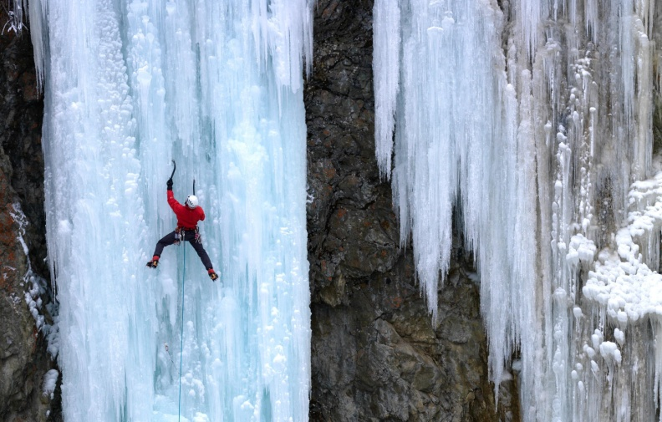
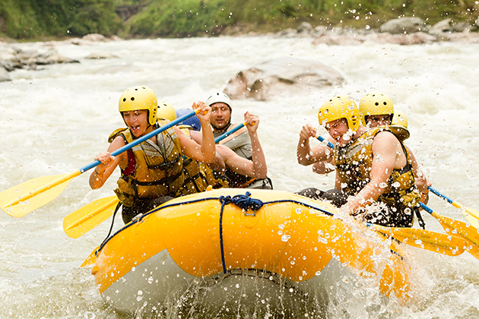
Task 4. Imagine that you and your friend are doing a school project “Extreme activities”. You have found some illustrations and want to share the news. Leave a voice message to your friend. In 2.5 minutes be ready to:
- explain the choice of the illustrations for the project by briefly describing them and noting the differences;
- mention the advantages (1–2) of the two extreme activities;
- mention the disadvantages (1–2) of the two extreme activities;
- express your opinion on the subject of the project – which of the extreme activities presented in the pictures you’d prefer and why.
You will speak for not more than 3 minutes (12–15 sentences). You have to talk continuously.
Photo 1 Photo 2
Introduction

Slide 39
Task 4. Imagine that you and your friend are doing a school project “Extreme activities”. You have found some illustrations and want to share the news. Leave a voice message to your friend. In 2.5 minutes be ready to:
- explain the choice of the illustrations for the project by briefly describing them and noting the differences;
- mention the advantages (1–2) of the two extreme activities;
- mention the disadvantages (1–2) of the two extreme activities;
- express your opinion on the subject of the project – which of the extreme activities presented in the pictures you’d prefer and why.
You will speak for not more than 3 minutes (12–15 sentences). You have to talk continuously.
Photo 1 Photo 2
Introduction
Brief description of the photos

Slide 40
Task 4. Imagine that you and your friend are doing a school project “Extreme activities”. You have found some illustrations and want to share the news. Leave a voice message to your friend. In 2.5 minutes be ready to:
- explain the choice of the illustrations for the project by briefly describing them and noting the differences;
- mention the advantages (1–2) of the two extreme activities;
- mention the disadvantages (1–2) of the two extreme activities;
- express your opinion on the subject of the project – which of the extreme activities presented in the pictures you’d prefer and why.
You will speak for not more than 3 minutes (12–15 sentences). You have to talk continuously.
Photo 1 Photo 2
Introduction
Brief description of the photos
Noting the difference

Slide 41
Task 4. Imagine that you and your friend are doing a school project “Extreme activities”. You have found some illustrations and want to share the news. Leave a voice message to your friend. In 2.5 minutes be ready to:
- explain the choice of the illustrations for the project by briefly describing them and noting the differences;
- mention the advantages (1–2) of the two extreme activities;
- mention the disadvantages (1–2) of the two extreme activities;
- express your opinion on the subject of the project – which of the extreme activities presented in the pictures you’d prefer and why.
You will speak for not more than 3 minutes (12–15 sentences). You have to talk continuously.
Photo 1 Photo 2
Introduction
Brief description of the photos
Noting the difference
Advantages and disadvantages (photo 1)

Slide 42
Task 4. Imagine that you and your friend are doing a school project “Extreme activities”. You have found some illustrations and want to share the news. Leave a voice message to your friend. In 2.5 minutes be ready to:
- explain the choice of the illustrations for the project by briefly describing them and noting the differences;
- mention the advantages (1–2) of the two extreme activities;
- mention the disadvantages (1–2) of the two extreme activities;
- express your opinion on the subject of the project – which of the extreme activities presented in the pictures you’d prefer and why.
You will speak for not more than 3 minutes (12–15 sentences). You have to talk continuously.
Photo 1 Photo 2
Introduction
Brief description of the photos
Noting the difference
Advantages and disadvantages (photo 1)
Advantages and disadvantages (photo 2)

Slide 43
Task 4. Imagine that you and your friend are doing a school project “Extreme activities”. You have found some illustrations and want to share the news. Leave a voice message to your friend. In 2.5 minutes be ready to:
- explain the choice of the illustrations for the project by briefly describing them and noting the differences;
- mention the advantages (1–2) of the two extreme activities;
- mention the disadvantages (1–2) of the two extreme activities;
- express your opinion on the subject of the project – which of the extreme activities presented in the pictures you’d prefer and why.
You will speak for not more than 3 minutes (12–15 sentences). You have to talk continuously.
Photo 1 Photo 2
Introduction
Brief description of the photos
Noting the difference
Advantages and disadvantages (photo 1)
Advantages and disadvantages (photo 2)
Opinion on the subject

Slide 44
Task 4. Imagine that you and your friend are doing a school project “Extreme activities”. You have found some illustrations and want to share the news. Leave a voice message to your friend. In 2.5 minutes be ready to:
- explain the choice of the illustrations for the project by briefly describing them and noting the differences;
- mention the advantages (1–2) of the two extreme activities;
- mention the disadvantages (1–2) of the two extreme activities;
- express your opinion on the subject of the project – which of the extreme activities presented in the pictures you’d prefer and why.
You will speak for not more than 3 minutes (12–15 sentences). You have to talk continuously.
Photo 1 Photo 2
Introduction
Brief description of the photos
Noting the difference
Advantages and disadvantages (photo 1)
Advantages and disadvantages (photo 2)
Opinion on the subject
What you prefer/would prefer/ like…. and why

Slide 45
Task 4. Imagine that you and your friend are doing a school project “Extreme activities”. You have found some illustrations and want to share the news. Leave a voice message to your friend. In 2.5 minutes be ready to:
- explain the choice of the illustrations for the project by briefly describing them and noting the differences;
- mention the advantages (1–2) of the two extreme activities;
- mention the disadvantages (1–2) of the two extreme activities;
- express your opinion on the subject of the project – which of the extreme activities presented in the pictures you’d prefer and why.
You will speak for not more than 3 minutes (12–15 sentences). You have to talk continuously.
Photo 1 Photo 2
Introduction
Brief description of the photos
Noting the difference
Advantages and disadvantages (photo 1)
Advantages and disadvantages (photo 2)
Opinion on the subject
What you prefer/would prefer/ like…. and why
Closing remark

Slide 46
Task 4. Imagine that you and your friend are doing a school project “Extreme activities”. You have found some illustrations and want to share the news. Leave a voice message to your friend. In 2.5 minutes be ready to:
- explain the choice of the illustrations for the project by briefly describing them and noting the differences;
- mention the advantages (1–2) of the two extreme activities;
- mention the disadvantages (1–2) of the two extreme activities;
- express your opinion on the subject of the project – which of the extreme activities presented in the pictures you’d prefer and why.
You will speak for not more than 3 minutes (12–15 sentences). You have to talk continuously.
Photo 1 Photo 2
Well done!
Introduction
Brief description of the photos
Noting the difference
Advantages and disadvantages (photo 1)
Advantages and disadvantages (photo 2)
Opinion on the subject
What you prefer/would prefer/ like…. and why
Closing remark

Slide 47
ORGANISE
PATIENT
AMBITIOUS
GOALS
ANGER
ANXIETY
COMPLETE
HIGHER
PURPOSE
SENSE OF CONTROL
SURPRISE
FEAR
ZONE
LEARNING
ZONE
BOREDOM
COMFORT ZONE
FEAR
SAFETY
EXCITEMENT
SATISFIED
STAGNATION
MEANING
SAFE
STRESS
DEVELOPMENT
ABLE
MOTIVATED
SELF-GROWTH

Slide 48
Ready to go Extreme?

